Slide 1


Slide 2
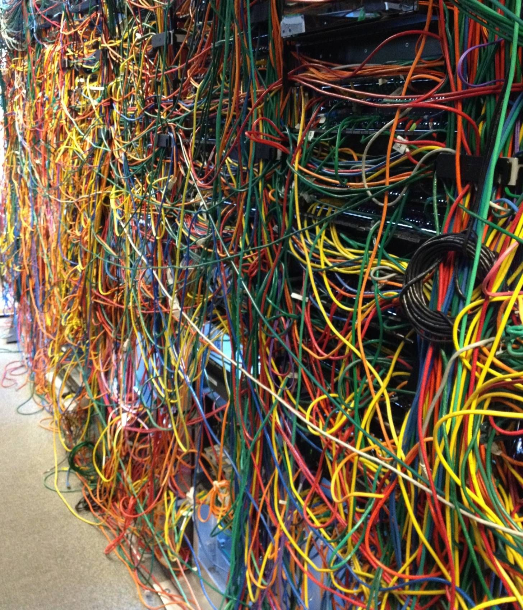

Slide 3


Slide 4
The makings of Scully

Slide 5
Meet Scully, your friendly SSG

Slide 6

Sander Elias
Lead architect @Scully
Senior principal engineer @HeroDevs
GDE Web Technology
GDE Angular
Dutch Angular Group founder
Active in online communities
Available for a chat

Slide 7
An Static Site Generator?
Speeds up your app
Makes it SEO friendly
Less to no dependencies on API servers
Easier to host
Can make JS optional.

Slide 8
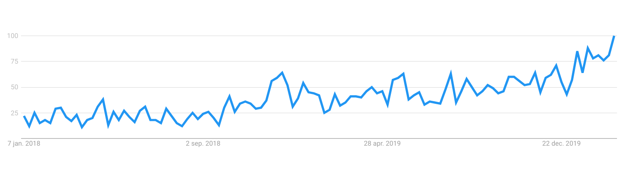
A #JAMSTACK?
Google sees an growing interest

Slide 9
Scully enables
#JAMSTACK for your app
For more information about the JamStack check out:
Non-Server Side Story: When JAMstack met Angular
by
Divya Tagtachian and Tara Z. Manicsic

Slide 10
Enough theory.
Let me introduce my sample app

Slide 11
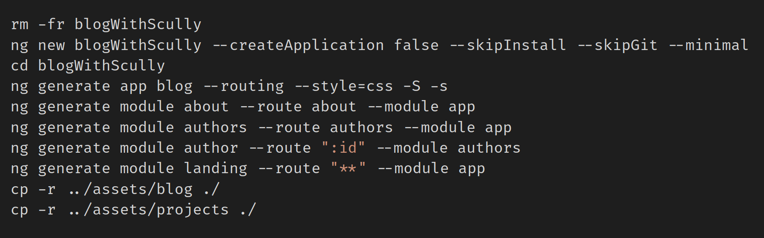
How did I get started?
I used a script

Slide 12
1 - intro

Slide 13
Recap
A (on purpose) very simple Angular app
Get data from API rest back-end
Served by `ng serve`

Slide 14
Lets add Scully!

Slide 15
2-add

Slide 16
Recap
Adding Scully is easy!
But is that really all?

Slide 17
Ok, we will run & see

Slide 18
3-run

Slide 19
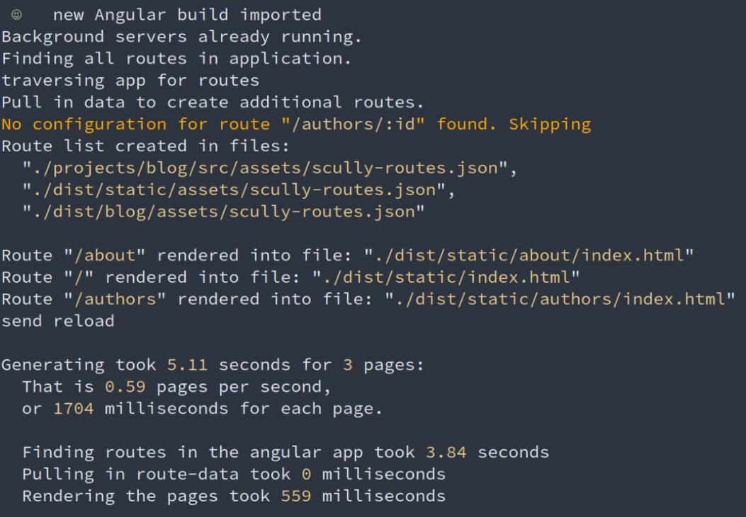
Lets look at the output:

Slide 20
Recap
That worked great!
However, it only generated 3 pages?
And what is this?
Scully does not know what to do,
Lets teach it.

Slide 21
4-teach

Slide 22
Recap
Now all pages got rendered.
How can we see what we have done?
Use `npm scully:serve`
Lets check out the result

Slide 23
5-show

Slide 24
Recap
That worked out quite wonderfully
However, that flicker?
Lets see what we can do

Slide 25
6-ff-1

Slide 26

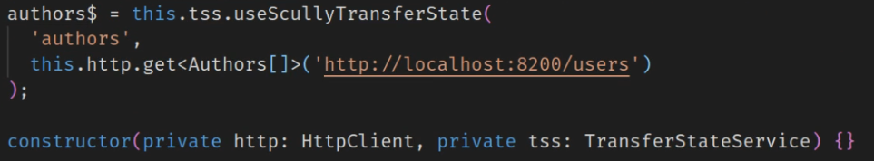
Hold on, not so fast...
Became:

Slide 27
Recap
We added the Scully transferState
What is the difference?

Slide 28
6-ff-2

Slide 29
Recap
Ok, all that is cool, But...
What about the actual blog?

Slide 30
7-blog

Slide 31
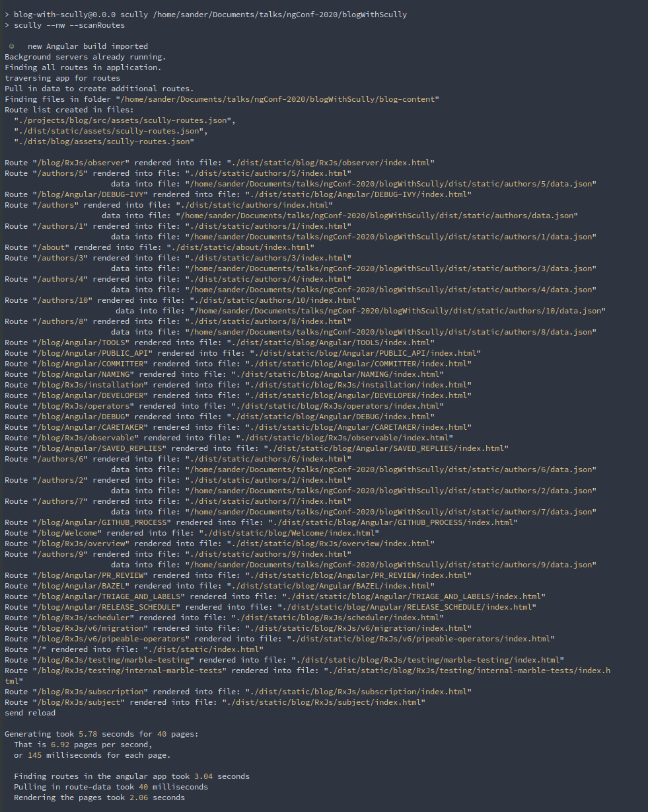
Background processing
Updated the code
This slide is doing the

Slide 32
8-final

Slide 33
Scully
Has an easy to implement transfer-state
Creates SEO optimized sites
Lowers the TTFP
Allows easy intergration of content/markdown
Very extendable plugin system

Slide 34
Thank you
Code will be available on
https://github.com/SanderElias/ngConf-2020
Scully:
https://scully.io/
Questions?
I’m available in the 1:20PM Q&A
On our Gitter channel, in my twitter DM’s

